Slide 1

Distributed Stencil Performance Analysis
High Performance Computing 297SM
23/01/2026
Luca Ricatti SM3800083
Distributed Stencil Performance Analysis
23/01/2026
1/29

Slide 2
Goal of the Assignment
Implement a parallel 5-point stencil to compute heat diffusion computation
Parallelize C code, combining the advantage of MPI for distributed memory communications and OpenMPI directives for shared memory.
Conduct scalability analysis in a Leonardo - Cineca High Performance / Productivity environment.
Luca Ricatti SM3800083
Distributed Stencil Performance Analysis
23/01/2026
2/29

Slide 3
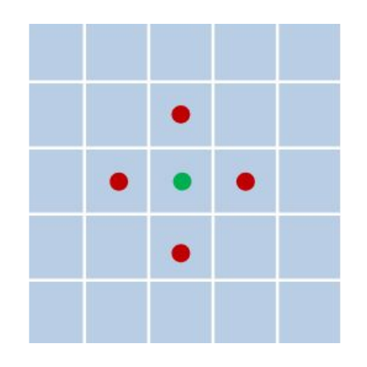
The 5-point stencil computation
Stencil computations have diverse applications including the numerical solution of partial differential equations, such as the heat equation for thermal diffusion process.
The continuous domain is discretized into a two dimensions grid where the state of each cell is updated iteratively. Using the finite difference method, a point's new value x_{ij}(t) is derived from the average of its previous value x_{ij}(t-1) and its four orthogonal neighbours.
The parallelization strategy decomposes the global simulation grid into local patches, assigning one patch per MPI rank.
This introduces data dependencies across process boundaries and necessitates inter-process communication.
5-point
Luca Ricatti SM3800083
Distributed Stencil Performance Analysis
23/01/2026
3/29

Slide 4
Parallelization strategy: Domain Decomposition
Parallelization begins by partitioning the global computational grid into smaller sub-grids, with each MPI process managing a specific region.
While internal points can be updated independently, the boundary points introduce dependencies on data held by neighbouring processes.
Border points at the edge of a local domain require values from adjacent domains to complete the stencil operation. Consequently, synchronization and data exchange between processes are performed at each time step.
Luca Ricatti SM3800083
Distributed Stencil Performance Analysis
23/01/2026
4/29

Slide 5
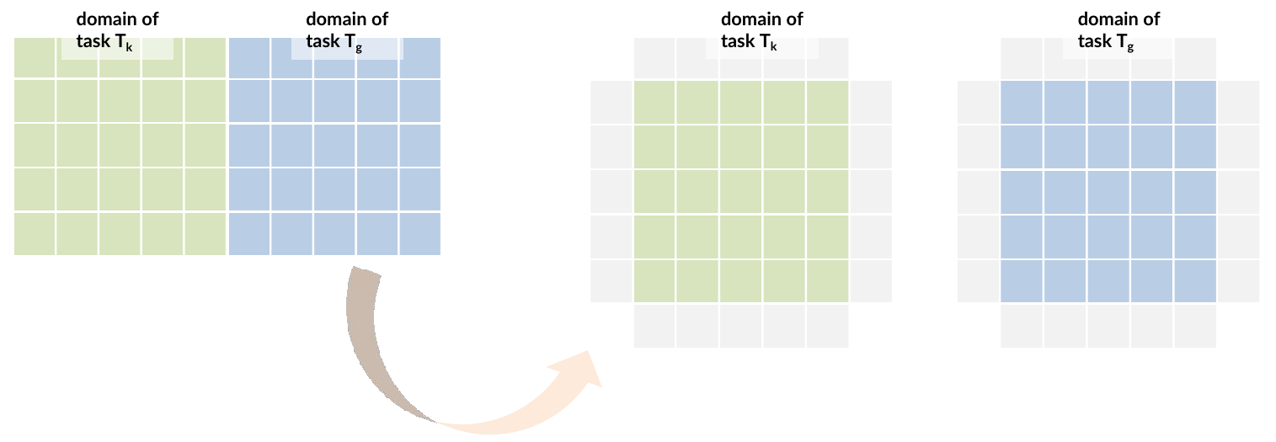
Parallelization strategy: Domain Decomposition
A custom 2D Cartesian topology that maps MPI ranks to grid coordinates was implemented.
Grid Partitioning: An automatic factorization algorithm simple_factorization()determines the optimal process grid dimensions to ensure load balancing and minimize the surface-to-volume ratio (square-like decomposition).
Luca Ricatti SM3800083
Distributed Stencil Performance Analysis
23/01/2026
5/29

Slide 6
Parallelization strategy: Domain Decomposition
Each process calculates its coordinates (X, Y) in the virtual grid using arithmetic operations (X = Rank / Grid[x], Y = Rank / Grid[x]), and determines its neighbours (N, S, E, W) through direct rank calculations. This manual approach provides explicit control over the decomposition logic and avoids the overhead of MPI topology management functions.
Luca Ricatti SM3800083
Distributed Stencil Performance Analysis
23/01/2026
6/29

Slide 7
Halo exchange: border computation
To enable border point computation, each MPI rank process reserves additional memory regions (Halo zones) surrounding its local grid patch, which will hold boundary values received from adjacent ranks.
The halo exchange follows a coordinated protocol: each rank prepares its boundary data, transmits it to neighbouring ranks via MPI, and simultaneously receives corresponding boundary data to populate its halo regions.
Implementation:
Non-blocking MPI calls (MPI_Isend / MPI_Irecv) for asynchronous communication
Inline implementation within the main loop (not separate functions) for minimal overhead
Parallel packing/unpacking using OpenMP (for East/West only) achieving 3-4× speedup
Self-communication optimization: If a neighbour is the same MPI rank (periodic boundaries), data is copied directly using OpenMP instead of MPI, eliminating network overhead
Luca Ricatti SM3800083
Distributed Stencil Performance Analysis
23/01/2026
7/29

Slide 8
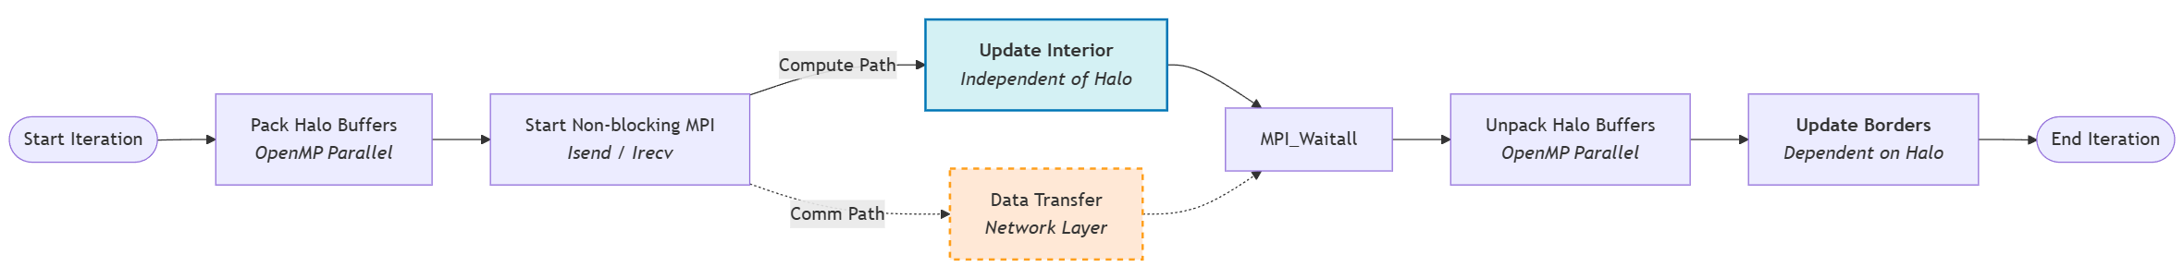
Communication-Computation Overlap
To hide the latency of MPI communications, a non-blocking communication strategy overlapped with computation was adopted. The halo exchange is implemented inline within the main iteration loop to minimize function call overhead and enable control over the communication pattern. The stencil update is split into two distinct kernels:
update_interior() Updates the inner core of the sub-grid, which does not depend on halo data. This function is parallelized using OpenMP (#pragma omp parallel for schedule(static)) to distribute the computation across threads within each MPI process.
update_borders() Updates the edges of the sub-grid, which depend on neighbour data. This function is also parallelized with OpenMP, using separate loops for horizontal and vertical borders to maximize cache efficiency.
Luca Ricatti SM3800083
Distributed Stencil Performance Analysis
23/01/2026
8/29

Slide 9
Halo Exchange Phases 1/4
Phase 1 - Halo Exchange Start (inline implementation):
East/West borders: Pack non-contiguous column data into contiguous send buffers using OpenMP parallelization.
North/South borders: Set up direct pointers to contiguous row data (no packing needed).
Post non-blocking receives (MPI_Irecv) for all neighbours, followed by non-blocking sends (MPI_Isend).
Self-communication optimization: If a neighbour is the same MPI rank (if periodic boundaries is active), copy data directly using OpenMP parallel loops instead of MPI calls, eliminating network overhead and reducing latency.
Luca Ricatti SM3800083
Distributed Stencil Performance Analysis
23/01/2026
9/29

Slide 10
Halo Exchange Phases 2/4
Phase 2 - Computation Overlap:
Immediately call update_interior()to compute interior points while MPI transfers halo data in the background. This function uses OpenMP to parallelize the computation across threads within the MPI process.
Luca Ricatti SM3800083
Distributed Stencil Performance Analysis
23/01/2026
10/29

Slide 11
Halo Exchange Phases 3/4
Phase 3 - Halo Exchange Finish:
Call MPI_Waitall()to ensure all communications are complete.
East/West: Unpack received data from buffers into halo regions using OpenMP parallelization.
North/South: Data is already in place via direct pointers (no unpacking needed).
Luca Ricatti SM3800083
Distributed Stencil Performance Analysis
23/01/2026
11/29

Slide 12
Halo Exchange Phases 4/4
Phase 4 – Border Computation:
Call update_borders()to compute border points using the fresh halo data. This function also uses OpenMP parallelization, with separate loops for horizontal and vertical borders to optimize cache access patterns.
Luca Ricatti SM3800083
Distributed Stencil Performance Analysis
23/01/2026
12/29

Slide 13
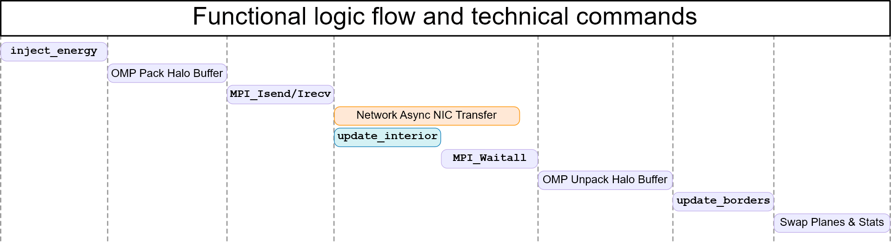
Parallel Stencil: GANTT Chart
OMP Pack / Unpack Halo Buffer: The #pragma omp parallel for schedule(static) directive parallelizes the loop that copies non-contiguous column data (East/West borders) into contiguous send buffers, distributing iterations evenly across OpenMP threads.
Luca Ricatti SM3800083
Distributed Stencil Performance Analysis
23/01/2026
13/29

Slide 14
#pragma omp parallel for schedule(static) 1/5
#pragma omp parallel for schedule(static)
This directive is a combined construct that spawns a team of threads (parallel) and immediately distributes the iterations of the following loop across those threads (for).
The schedule(static) clause dictates the partitioning strategy: the total number of loop iterations is divided into equal-sized chunks (by default, total_iterations / num_threads) and assigned to threads in a round-robin fashion at the start of the parallel region.
Because the mapping is deterministic and fixed before execution begins, static scheduling introduces near-zero runtime synchronization overhead compared to dynamic or guided schedules. This makes it the optimal choice for loops with uniform computational intensity per iteration and no load imbalance (e.g., copying a rectangular memory region).
Furthermore, when used consistently across multiple loops operating on the same data structures, it promotes NUMA locality: the same thread that initializes a memory page (via first-touch) is likely to process it in subsequent loops, ensuring data remains in the CPU's local cache or L1/L2 cache.
Luca Ricatti SM3800083
Distributed Stencil Performance Analysis
23/01/2026
14/29

Slide 15
#pragma omp parallel for schedule(static) 2/5
#pragma omp parallel for schedule(static)
Stencil Computation (Core Loops)
update_interior(): Parallelizes interior grid points computation (1 pragma)
Loop bounds: j ∈ [2, ysize-1], i ∈ [2, xsize-1] (excludes borders)
Executes during MPI communication overlap
update_borders(): Parallelizes border points computation (2 pragmas)
Horizontal borders (top/bottom): separate loop
Vertical borders (left/right): separate loop
Requires halo data from neighbours
Luca Ricatti SM3800083
Distributed Stencil Performance Analysis
23/01/2026
15/29

Slide 16
#pragma omp parallel for schedule(static) 3/5
#pragma omp parallel for schedule(static)
Halo Exchange Operations
Pack East/West buffers: Parallel copying of non-contiguous column data into send buffers (2 pragmas)
Self-communication: When neighbor == own rank, parallel copy replaces MPI calls (4 pragmas for all directions)
Unpack East/West buffers: Parallel copying of received data into ghost cells (2 pragmas)
Luca Ricatti SM3800083
Distributed Stencil Performance Analysis
23/01/2026
16/29

Slide 17
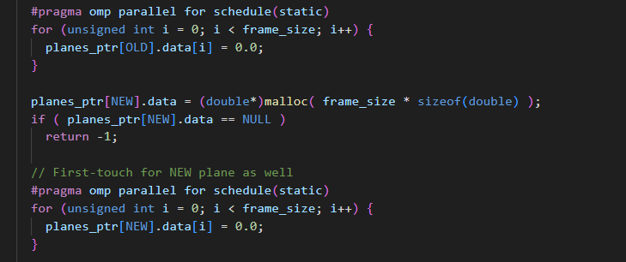
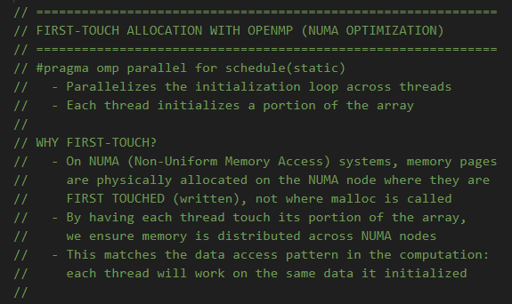
#pragma omp parallel for schedule(static) 4/5
#pragma omp parallel for schedule(static)
Memory Management
First-touch NUMA allocation: Parallel initialization of grid memory for NUMA-aware placement (2 pragmas for OLD and NEW planes)
Ensures memory pages allocated on local NUMA nodes
Luca Ricatti SM3800083
Distributed Stencil Performance Analysis
23/01/2026
17/29

Slide 18
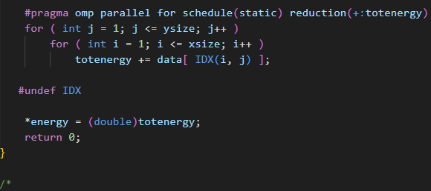
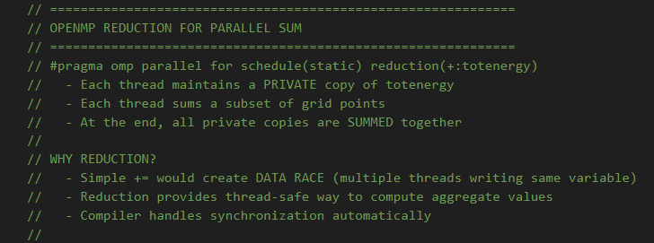
#pragma omp parallel for schedule(static) 5/5
#pragma omp parallel for schedule(static)
Reduction Operations
get_total_energy(): Parallel sum using reduction(+:totenergy) (1 pragma)
Thread-safe global energy calculation across all grid points
Luca Ricatti SM3800083
Distributed Stencil Performance Analysis
23/01/2026
18/29

Slide 19
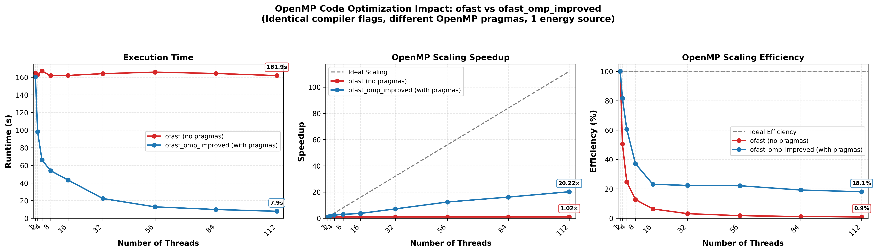
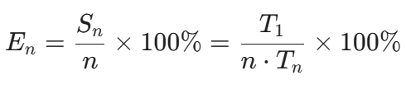

#pragma omp – Serial implementation
Test Parameters:
Grid Size: 16384 x 16384
Iterations: 500
Platform: Leonardo DCGP (2x Intel Xeon Platinum 8480+, 112 cores) - 1 node used
The results demonstrate that the -fopenmp compiler flag acts solely as a runtime enabler. Without explicit #pragma omp directives, the ofast variant executes on a single master thread, leaving the remaining 111 cores idle.
Speedup fixed problem size:
The dashed line represents Ideal Scaling . The divergence observed in ofast_omp_improved after 32 threads highlights the transition from a compute-limited regime to a memory-bandwidth limited regime.
OpenMP Scaling Efficiency:
Ideal behavior is represented by E_{n} = 100%. The sharp decline in efficiency as threads increase is indicative of the memory wall. Since the 5-point stencil has low arithmetic intensity, memory bus becomes the primary bottleneck once the aggregate request rate from the cores exceeds the available bandwidth.
Luca Ricatti SM3800083
Distributed Stencil Performance Analysis
23/01/2026
19/29

Slide 20
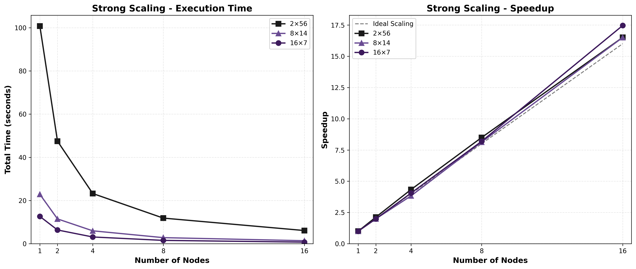
Strong Scaling Results (1/4)
Luca Ricatti SM3800083
Distributed Stencil Performance Analysis
23/01/2026
20/29

Slide 21
Strong Scaling Results (2/4)
Test Parameters
Grid Size: 16384 x 16384
Iterations: 500
Platform: Leonardo DCGP – from 1 to 16 nodes
16x7 (Many-MPI): 16 tasks/node, 7 threads/task
8x14 (Standard): 8 tasks/node, 14 threads/task
2x56 (Few-tasks): 2 tasks/node, 56 threads/task
Analysis of Results
2x56: Too many threads sharing the same MPI rank create excessive contention for the memory bandwidth, resulting in a much slower baseline (100.77s vs 12.64s on 1 node).
8x14: balanced configuration with 103.1% efficiency.
16x7: achieved the fastest absolute time-to-solution (0.72s at 16 nodes) and the highest speedup (17.46x)
Config | Nodes | Time (s) | Speedup | Efficiency
2x56 | 16 | 6.10 | 16.51x | 103.2 %
8x14 | 16 | 1.39 | 16.50x | 103.1 %
16x7 | 16 | 0.72 | 17.46x | 109.1 %
Luca Ricatti SM3800083
Distributed Stencil Performance Analysis
23/01/2026
21/29

Slide 22
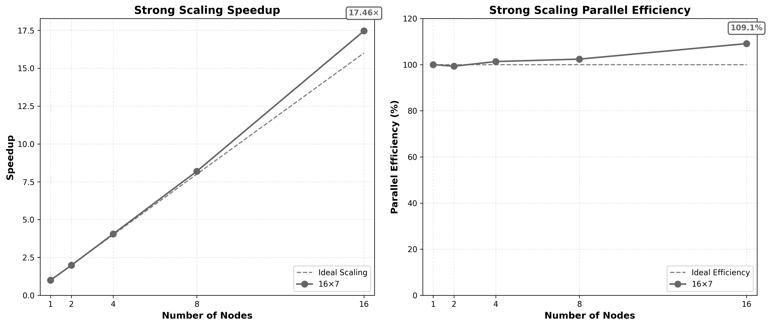
Strong Scaling Results (3/4)
At small scales, the implementation follows the ideal line closely, achieving a speedup of 1.90x on 2 nodes (near-perfect efficiency)
At 16 nodes (1792 cores), the implementation achieves a 17.46x speedup with a parallel efficiency of 109.1%:
Performance surpasses the theoretical ideal (Super-linear Scaling), transcending standard expectations of Amdahl's Law; as the local problem size per node decreases, cache fitting allows the working set to reside in high-speed memory, effectively mitigating the memory-bandwidth bottleneck
Luca Ricatti SM3800083
Distributed Stencil Performance Analysis
23/01/2026
22/29

Slide 23
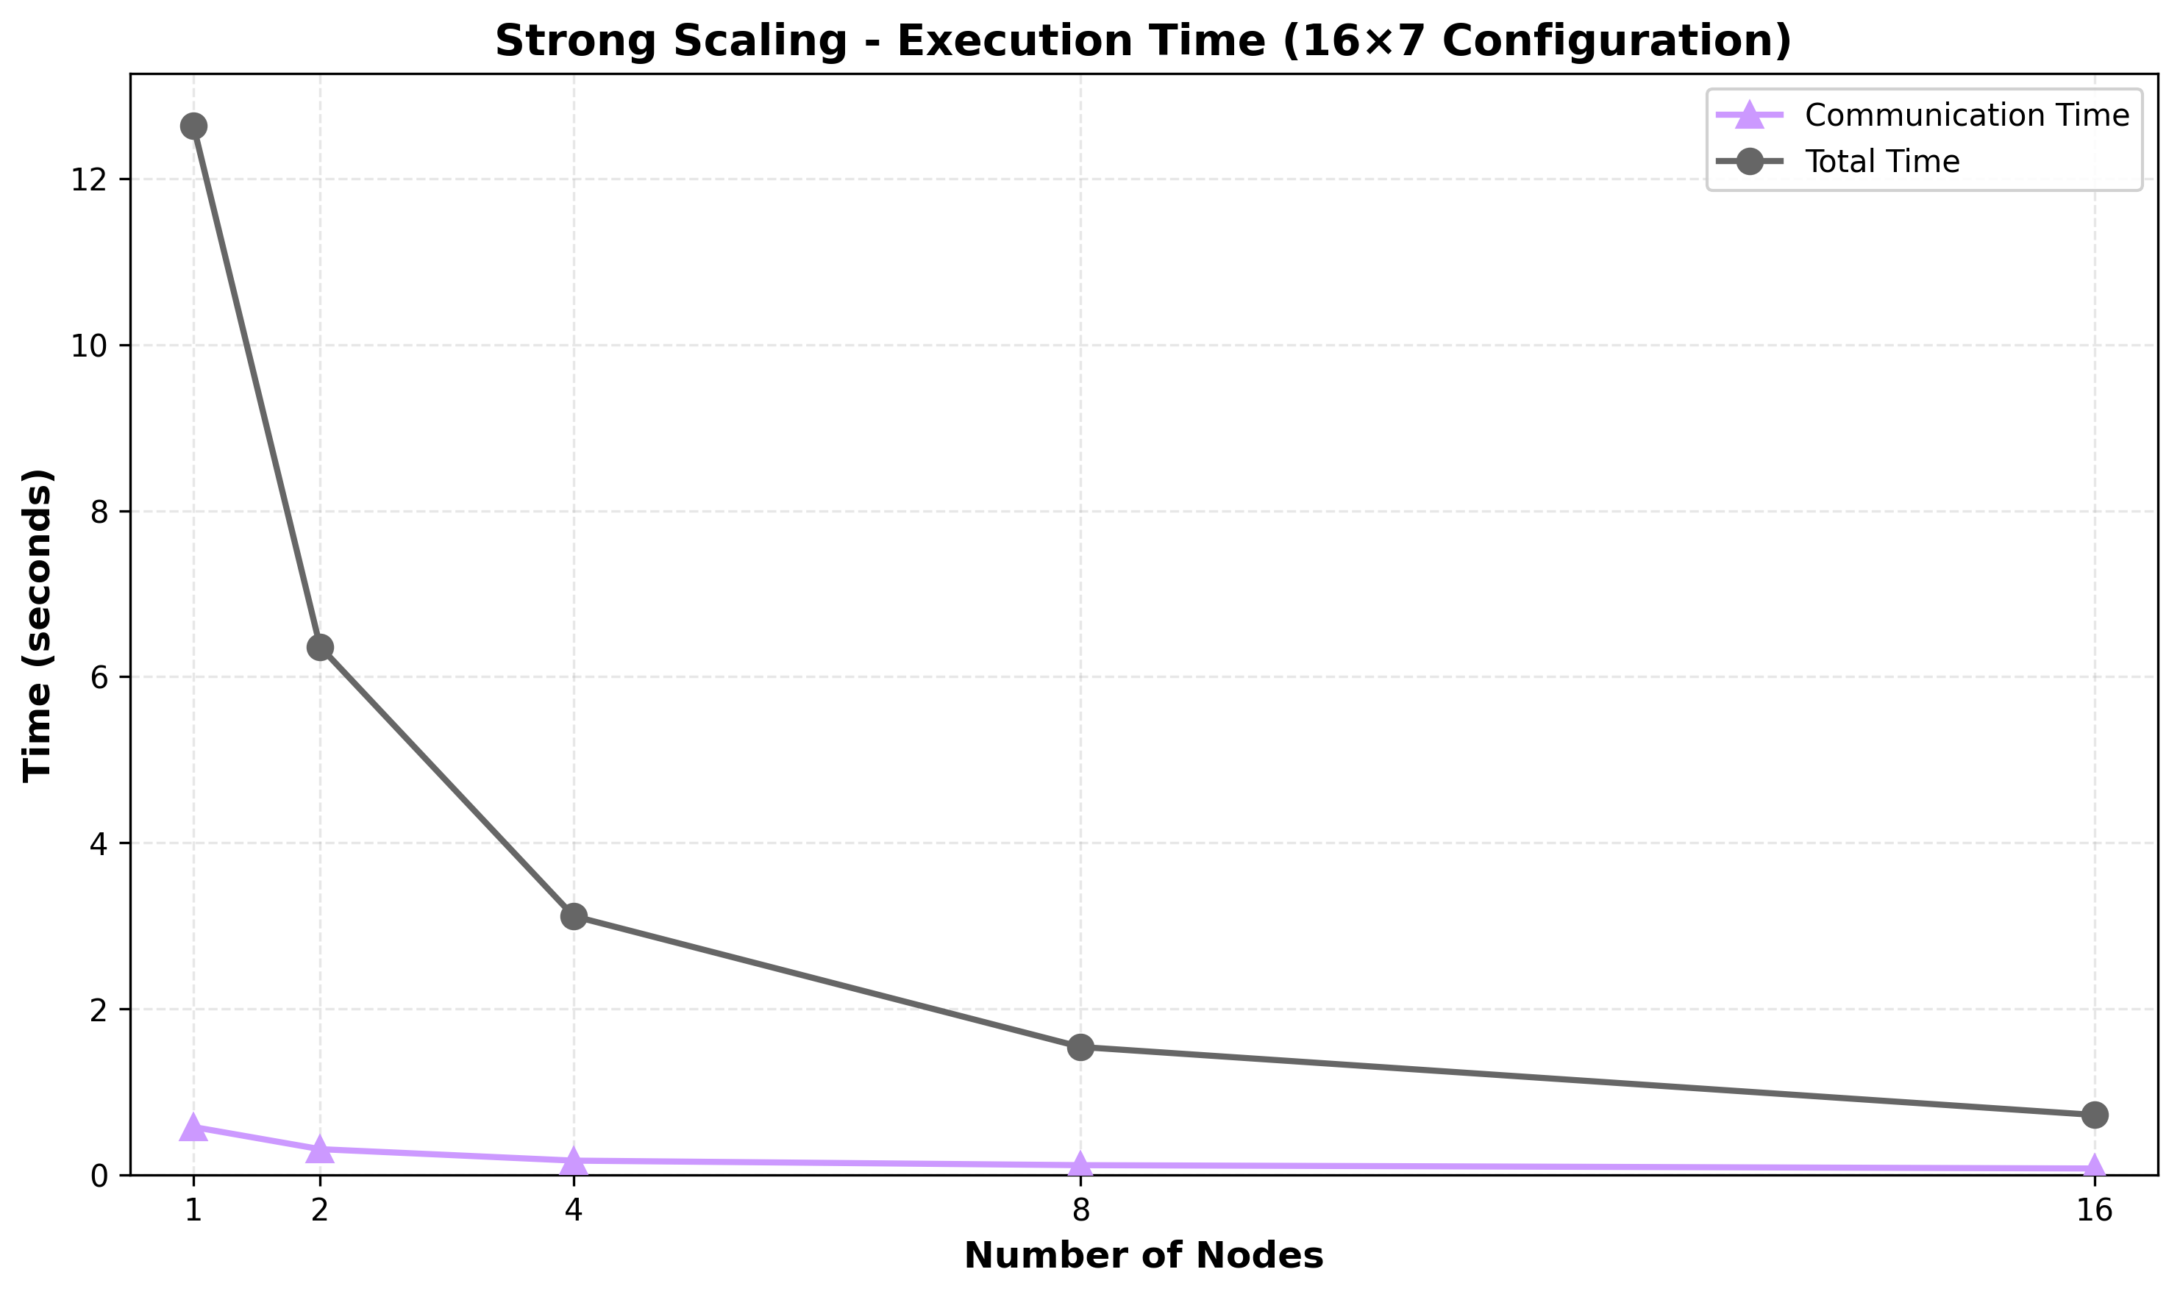
Strong Scaling Results (4/4)
Low Communication Overhead
Despite scaling from 16 to 256 MPI tasks (1 to 16 nodes), the communication time represents a small and well-controlled fraction of total execution time:
1 node: 4.6% of 12.64s
2 nodes: 4.9% of 6.36s
4 nodes: 5.6% of 3.12s
8 nodes: 7.7% of 1.54s
16 nodes: 10.9% of 0.72s
Luca Ricatti SM3800083
Distributed Stencil Performance Analysis
23/01/2026
23/29

Slide 24
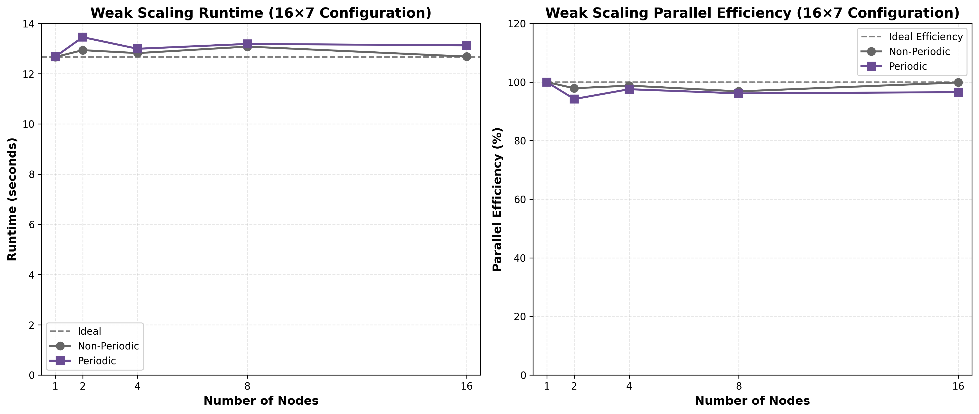
Weak Scaling Results (1/3)
Luca Ricatti SM3800083
Distributed Stencil Performance Analysis
23/01/2026
24/29

Slide 25
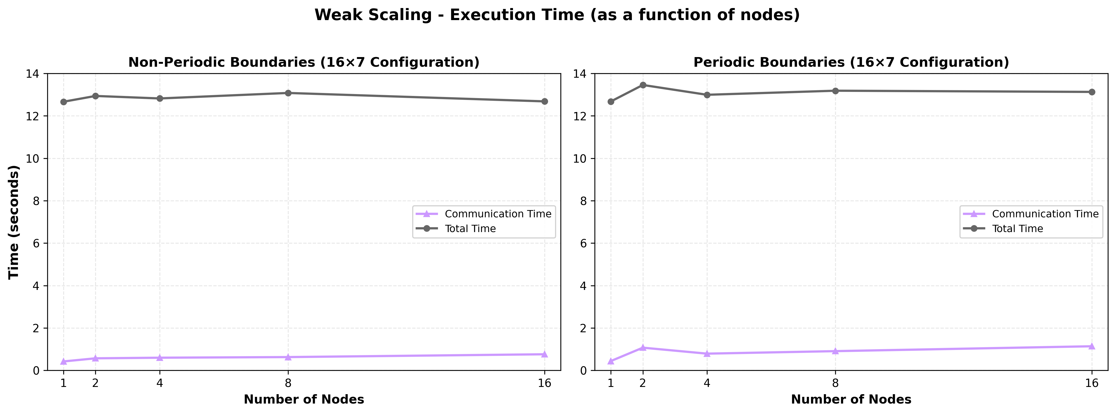
Weak Scaling Results (2/3)
Luca Ricatti SM3800083
Distributed Stencil Performance Analysis
23/01/2026
25/29

Slide 26
Weak Scaling Results (3/3)
Nodes (16x7) | Grid | Points (10^9) | Runtime | Computation | Commu-nication | Efficiency | Runtime (Period.) | Computation (Period.) | Commu-nication (Period.) | Efficiency (Period.)
1 | 16384² | 0.26 | 12.66 | 12.52 | 0.42 | 100.0 % | 12.68 | 12.53 | 0.44 | 100.0 %
2 | 23170² | 0.53 | 12.94 | 12.80 | 0.57 | 97.9 % | 13.46 | 13.31 | 1.07 | 94.2 %
4 | 32768² | 1.07 | 12.82 | 12.79 | 0.60 | 98.8 % | 12.99 | 12.90 | 0.79 | 97.6 %
8 | 46340² | 2.15 | 13.08 | 12.95 | 0.63 | 96.9 % | 13.19 | 13.10 | 0.91 | 96.1 %
16 | 65536² | 4.29 | 12.68 | 12.77 | 0.76 | 99.9 % | 13.13 | 13.13 | 1.14 | 96.6 %
The implementation achieves excellent weak scaling (>96% efficiency) for both boundary conditions. The periodic boundary overhead is acceptable and expected, as wrap-around communication requires additional network routing compared to fixed boundaries.
Non-periodic boundaries maintain more consistent runtime across scales (coefficient of variation: 1.3%), while periodic boundaries show higher variability (2.6%), especially at 2 nodes where efficiency drops to 94.2%. This suggests that wrap-around communication introduces overhead that becomes more significant at smaller scales where boundary processes represent a larger fraction of total processes.
Communication time increases with problem size for both boundary types, but the absolute increase is modest (0.34s for non-periodic, 0.70s for periodic over 16× scaling), demonstrating that the communication-computation overlap strategy effectively manages the growing communication volume.
Luca Ricatti SM3800083
Distributed Stencil Performance Analysis
23/01/2026
26/29

Slide 27
Main Achievements & Conclusions
Scalability: The implementation achieves Super-linear Scaling (up to 109.1% efficiency) in strong scaling and near-perfect weak scaling (>96% efficiency).
Overlap: The communication-computation overlap strategy (interior/border split) reduced communication overhead to <10% of total time.
NUMA: The adoption of a NUMA-aware first-touch allocation strategy ensured data locality and prevented performance degradation from cross-socket memory access, effectively maximizing local bandwidth utilization.
OpenMP effect: 18 pragmas led to a 20x speedup compared to non-parallelized code at 112 threads.
Memory Wall: Efficiency drops beyond 16-32 threads within a node, confirming the stencil's nature as a memory-bandwidth bound application.
Luca Ricatti SM3800083
Distributed Stencil Performance Analysis
23/01/2026
27/29

Slide 28
References
Course Repository: https://github.com/Foundations-of-HPC/High-Performance-Computing-2024
Project Repository: https://github.com/egesia1/5-points-stencil
MPI Standard: https://www.mpi-forum.org/docs/mpi-5.0/mpi50-report.pdf
OpenMP API: https://www.openmp.org/
Leonardo HPC System: https://leonardo-supercomputer.cineca.eu/it/leonardo-hpc-system/
Luca Ricatti SM3800083
Distributed Stencil Performance Analysis
23/01/2026
28/29

Slide 29

That’s all folks,
Luca Ricatti SM3800083
Distributed Stencil Performance Analysis
23/01/2026
29/29

